Slide 1
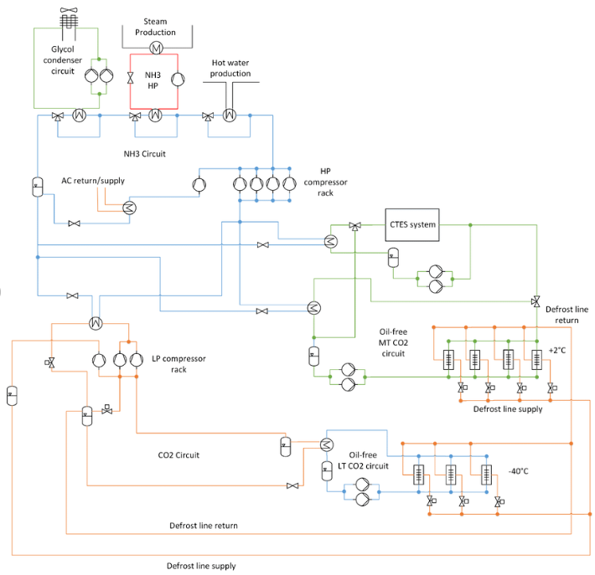

03. PLANT PROCESS LAYOUT

Slide 2
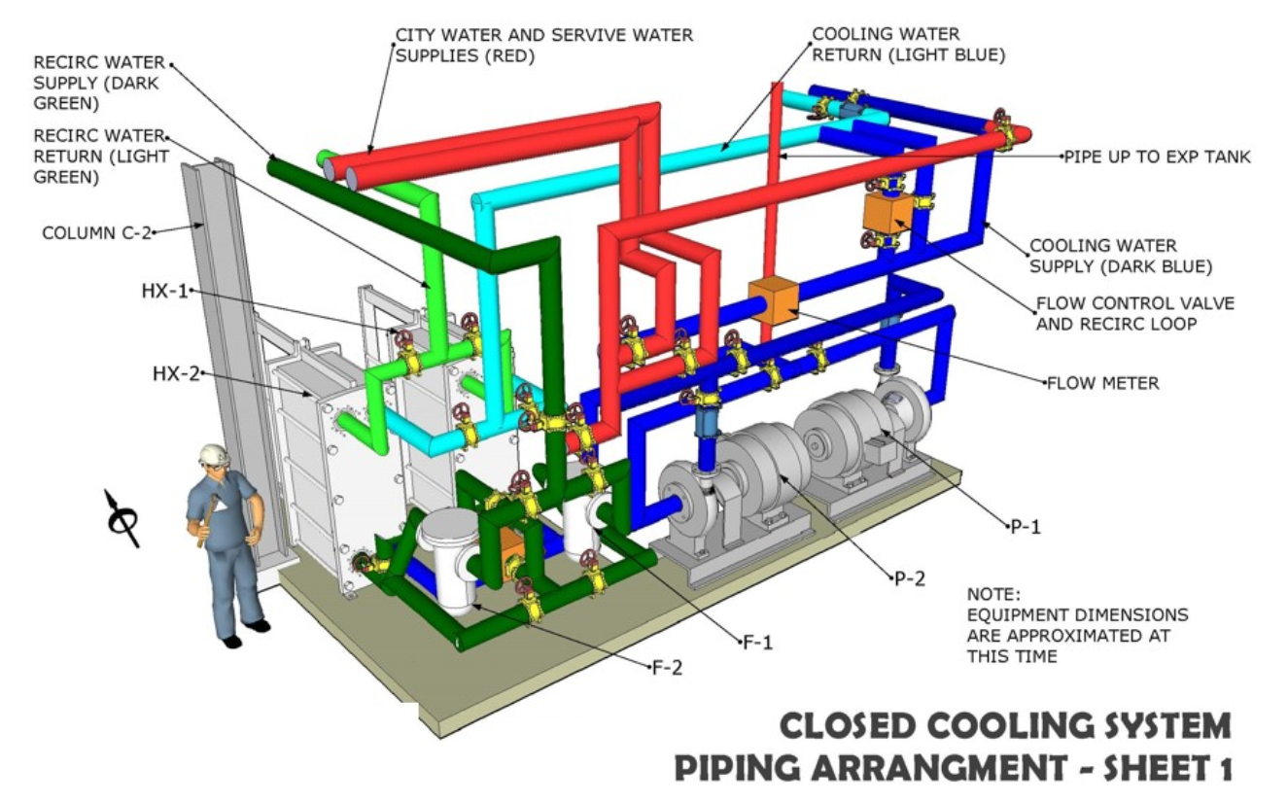
03. PLANT PROCESS LAYOUT

